Slide 1

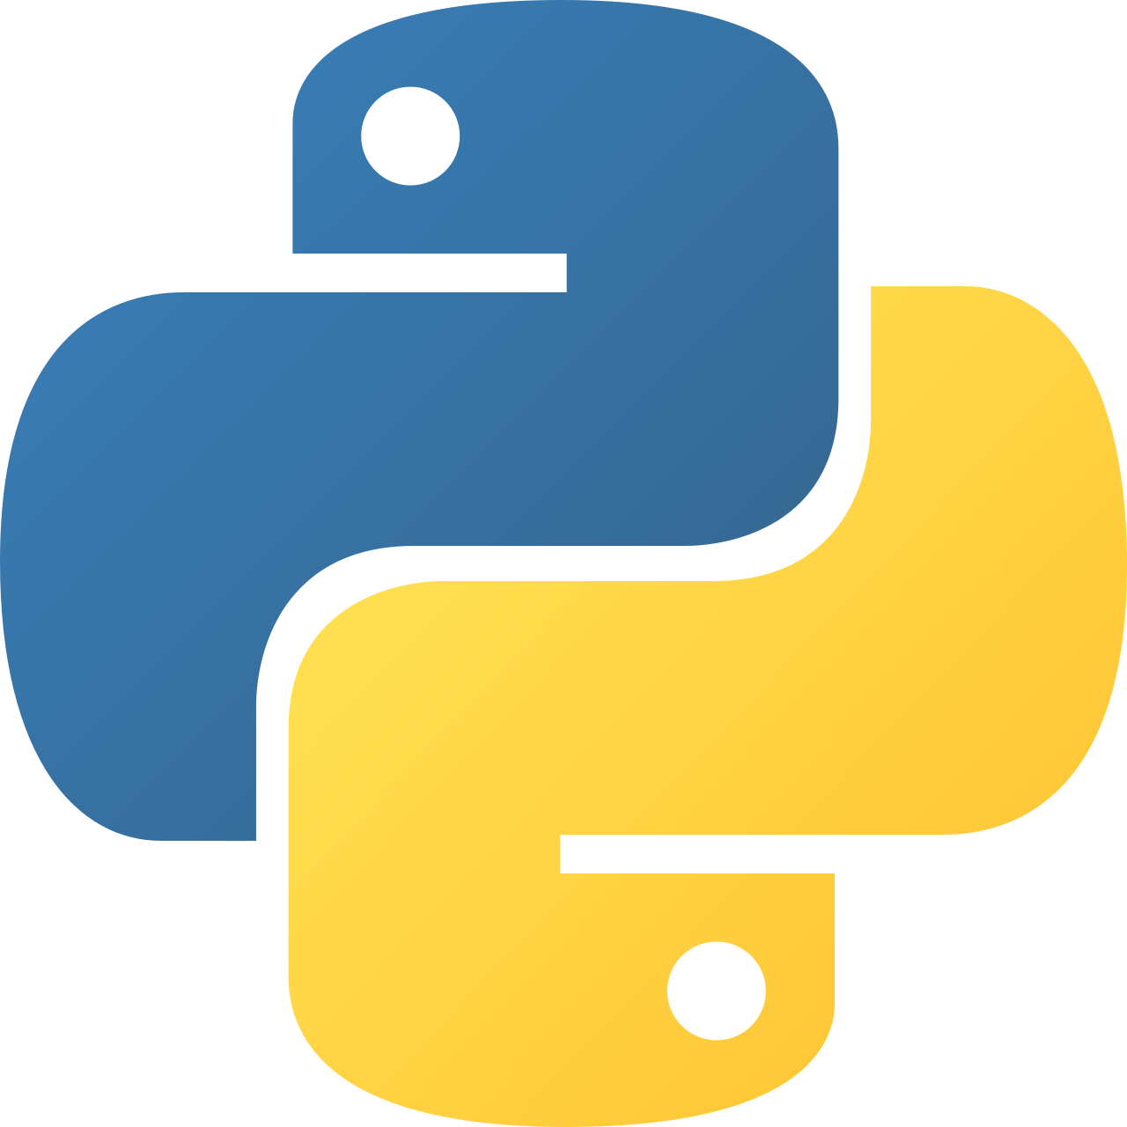
Intermediate Python
Designing with Exception

Slide 2
Exception Design Patterns
Design exceptions as part of your API, not as afterthoughts.
Use a base application exception (AppError) to group related errors
Create specific exception types for different failure causes
Prefer domain-level exceptions over raw ValueError / TypeError
Exception names should describe what failed, not how
Well-designed exceptions improve readability and recovery
Notes:
Exceptions are part of system design. A good exception hierarchy makes your code self-documenting and prevents vague “catch-all” error handling that hides real problems.

Slide 3
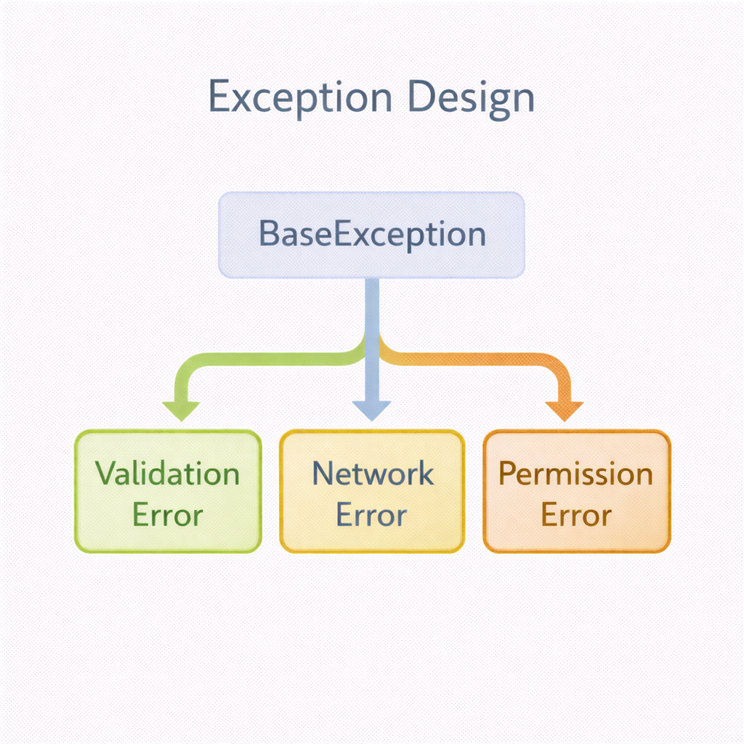

Slide 4
Control Flow with Exceptions
Exceptions handle exceptional paths, not normal logic.
Use try/except to handle unexpected failures
else runs only when no exception occurs
finally is for cleanup (files, locks, connections)
Avoid using exceptions as normal if/else logic
Let exceptions propagate when you can’t handle them meaningfully
I
Notes:
Exceptions change control flow. Overusing them as logic replacements makes code harder to reason about and debug.

Slide 5
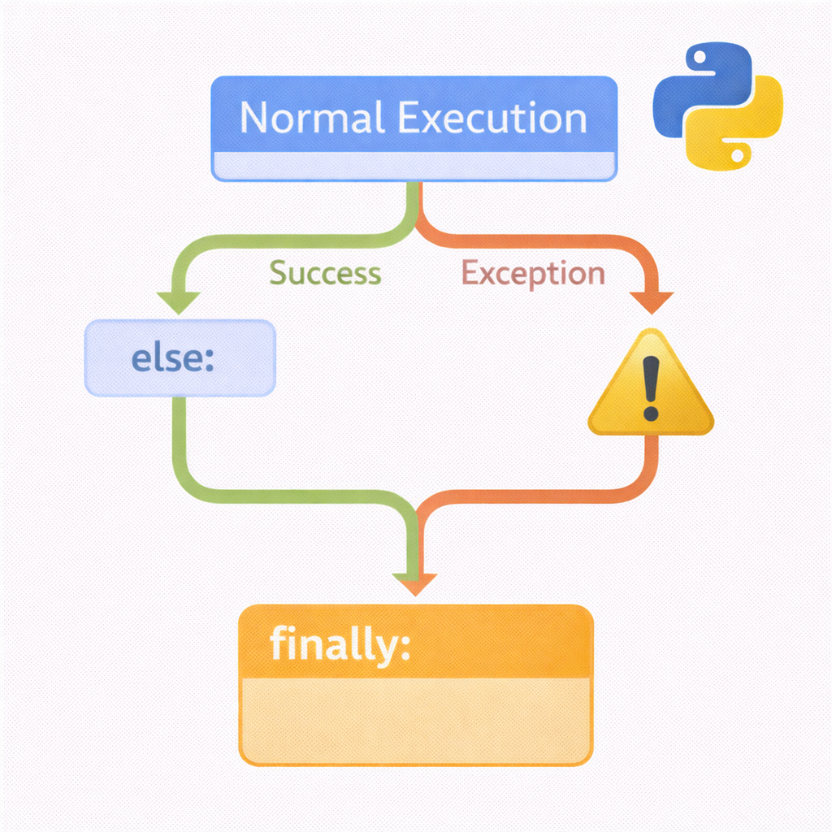

Slide 6
Debugging & Logging with Exceptions
Exceptions are most useful when they leave a trail.
Always log exceptions at system boundaries
Include context: user, operation, input state
Use exception chaining (raise X from e) to preserve root cause
Avoid swallowing exceptions silently
Logs should help you answer: what failed, where, and why
Notes:
A caught exception without logging is a lost debugging opportunity. Logs + chained exceptions are critical in production systems.

Slide 7
Best Practices for Exception Usage
Clear rules make exception handling predictable and safe.
Catch only exceptions you can handle or translate
Never use bare except: (always specify exception types)
Validate inputs early, fail fast
Keep exception messages clear and actionable
Prefer raising exceptions over returning error codes
Notes:
Exception best practices reduce hidden bugs and make systems easier to maintain, especially as teams and codebases grow.

Slide 8
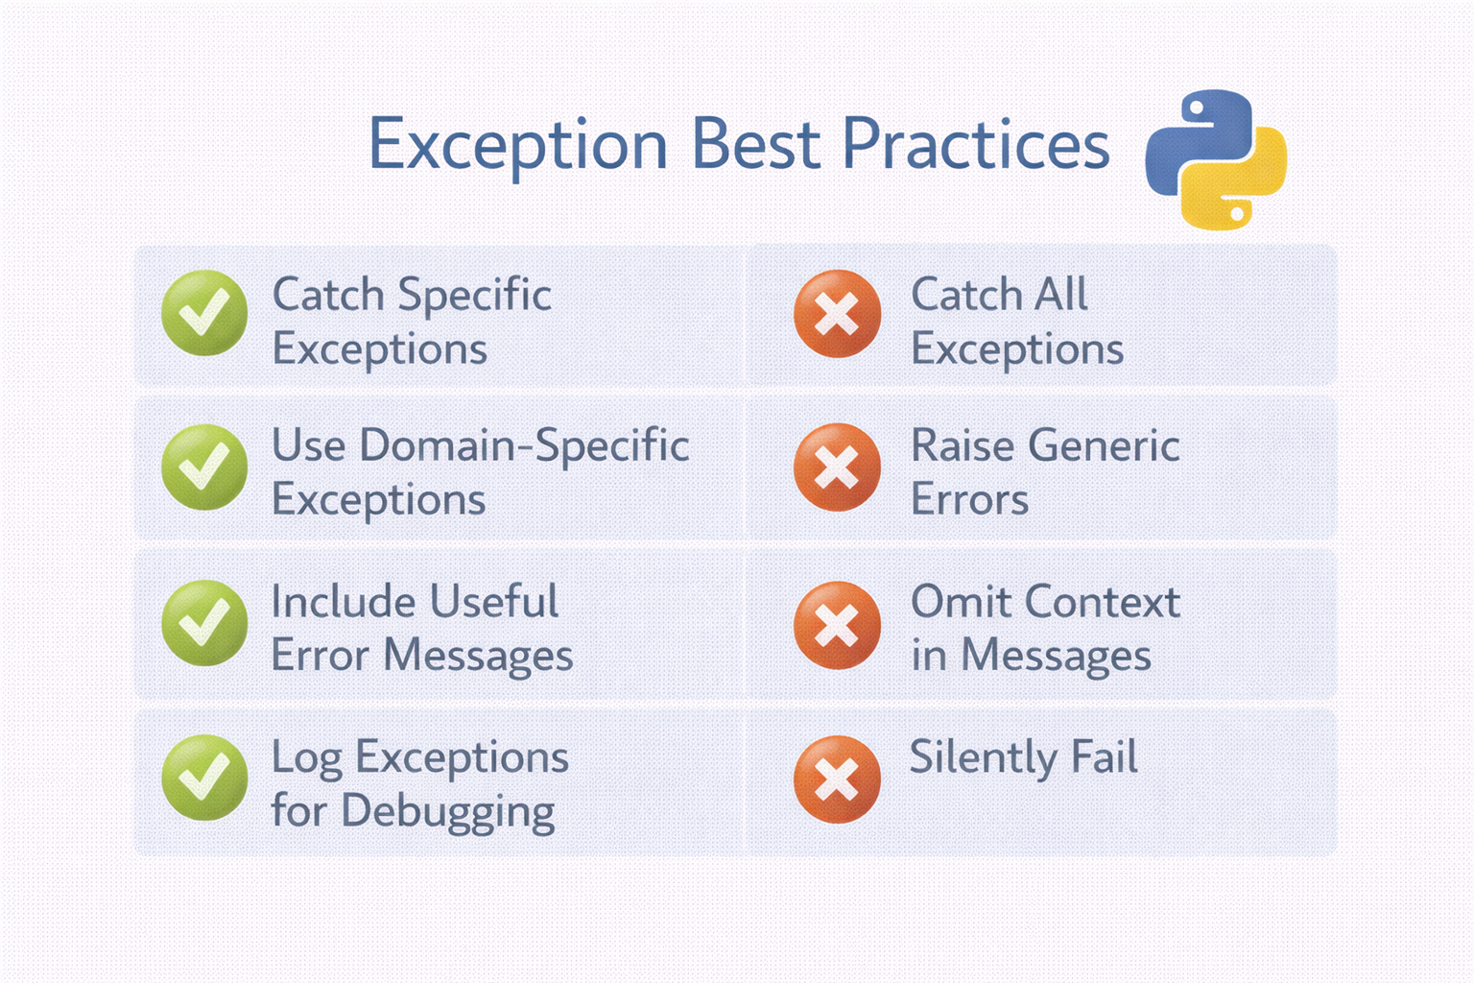

Slide 9
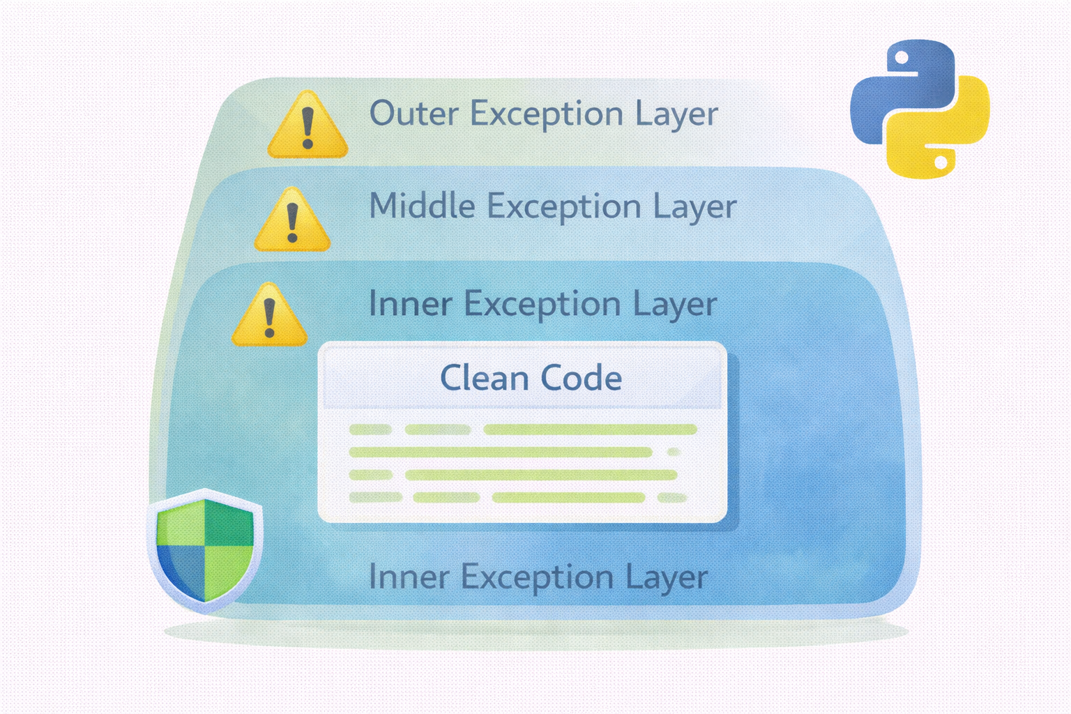
Exception Design Mindset (Wrap-Up)
Good exception design leads to robust, debuggable systems.
Exceptions communicate failure intent
Design exceptions like public interfaces
Control flow should remain readable
Debugging depends on clear exception signals
Consistent exception strategy scales with the system
Notes:
Think of exceptions as signals, not crashes. When designed intentionally, they make systems safer and developers more confident.

